Slide 1

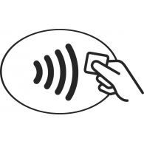
Near Field Communication (NFC)
INFO-F514 - Protocols, cryptanalysis and mathematical cryptology
Authentication
27-03-2017
Arabella Brayer

Slide 2
Content
Brief presentation
Definition, purposes and requirements
Several modes
NFC : a set of protocols
A typical authentication with NFC
Anti collision
Mutual authentication
One detailed example MIFARE Classic :
PRNG initialization
CRYPTO-1
Where is NFC today ?
Some progress have been made :
Opened protocols implemented
External certifications
Discussion :
Is the security sufficient now ? For what kind of use ?
27-03-2017
Arabella Brayer

Slide 3
Brief presentation
Definition, purposes and requirements
Field of RFID (Radio Frequency IDentification) : 13.56 MHz
Not like a magnetic-stripe : CPU
Another wireless connexion ?
Rate of 106, 212, 428 of 848 kbit/s -> slow, low distance, …
Different modes for different use (Active / Passive)
Read / Write (Tag and Reader) (P / A)
Emulation (P / A)
Peer-to-peer (A / A)
ISO/IEC 14443 1- 4 : Several layers (OSI model):
Physical characteristics
Radio frequency power and signal interface
Initialization and anticollision
Transmission protocol
27-03-2017
Arabella Brayer

Slide 4
Brief presentation
Where is the security ?
Depends of the class tag, and of others protocols
Class Tag :
ISO/IEC 14443A. read and re-write capable. Mem. 96 bytes - 2 kbyte
The same. Mem. 48 bytes - 2 kbytes
FeliCa. Mem. variable, theoretical mem. limit 1 MByte/service
Fully compatible ISO/IEC 14443A/B. Memory size can be up to 32 KBytes. For the communication with tags APDUs according to ISO 7816-4 (cryptographic applications) can be used.
Emulation : Application level, secure element, etc.
Peer-to-peer : NFC-SEC (see ECMA-385, 386)
Depends of device and utilization
27-03-2017
Arabella Brayer

Slide 5
Anticollision
Following the ISO/IEC 14443, an anti collision protocol must start the transaction. In this way, information between Tag and Reader will be exchanged:
Type of tag
ID (UID and now RID)
etc.
Afterward, the loop of anti collision can start.
...And then, the Authentication.
27-03-2017
Arabella Brayer

Slide 6
Authentication (1)
How to authenticate ?
Using (usually) symmetric scheme, because low power
but… lower security too.
Authentication (ISO/IEC 9798):
Reader and Smart card must share a secret key (k) before the process. Authentication is done by proving the possession of this secret key. For instance :
B choose a Random number (rB), send it to A
A sends the key k encrypted with rB : E_{k}(rB)
Then, B checks the result and the identity of A
How to process for the mutual authentication ?
Often use 3-pass mutual authentication
27-03-2017
Arabella Brayer
Notes:
https://www.cs.virginia.edu/~kn5f/Mifare.Cryptanalysis.htm
décrire le 3 pass mutual authentication au tableau

Slide 7
Authentication (2)
3-pass mutual authentication : challenge-response:
Reader sends a Random Number (rA) to Tag
Tag chooses a nonce (rB), encrypt rA and rB with k, and sends to Reader
Reader can decode rA and rB, and can identify Tag. Changes the sequence, sends it back to the Tag, that can check its identity too.
A → B : rB
A ← B : E_{k}(rA, rB)
A → B : E_{k}(rB, rA)
Security mainly based on RGN and Encryption/Decryption function.
Has been implemented on the MIFARE Classic Tag (1994) with :
a PRGN (based on an Linear Feedback Shift Register (LFSR))
CRYPTO-1 (proprietary)
(publicly) Broken in 2007
27-03-2017
Arabella Brayer

Slide 8
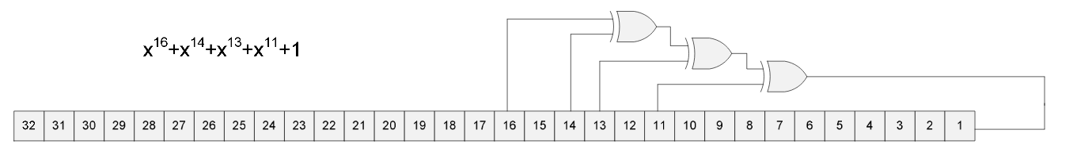
PRGN
Based on a LFSR
The register is 32-bits long, but the feedback uses only 16 lower bits
2¹⁶ combinations
Additional problems with initialization found : always the same initial state, ...
WEAK !!
MIFARE Classic PRGN
27-03-2017
Arabella Brayer
Notes:
demo of a LFSR computaion

Slide 9
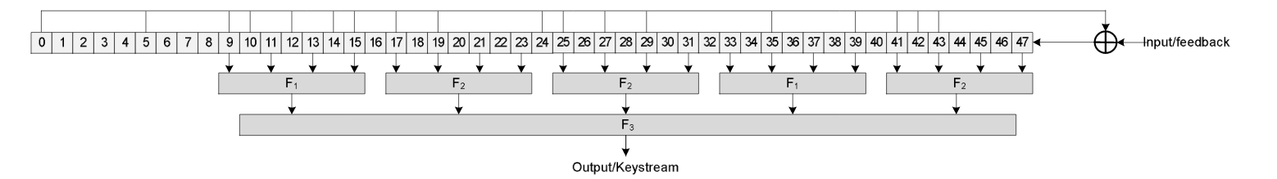
CRYPTO-1
Proprietary, known by reverse engineering (2007)
(Karsten Nohl, Henryk Plötz)
Consists of a LFSR and a function f(x)
Shift-register is first initialized with the secret key (48-bits)
PRGN products a 32-bits cipher that is XORed with the UID
Element passed in clear is used to initialize the register…
key of 48 bits, and weak PRNG, ...
27-03-2017
Arabella Brayer

Slide 10
CRYPTO-1
A lot of known attacks (not exhaustive):
Brute Force because of the 48-bits size key, but off-line
Keystream recovery :
Having a Reader and a (genuine) Tag
Eavesdrop the communication
Make sure that the card will use the same keystream
Modify the plaintext
p1 ⊕ K = c1
p2 ⊕ K = c2
Because of the weak PRGN, is possible
Authentication replay
Need a record of a successful authentication between tag and reader
Send authentication request until get the same nonce that the recorded
Send the recorded response …
Card-only
ISO/IEC 14443 require parity bits after 8 bits. MIFARE classic uses plaintext combined with repeated keystream
…
C1 ⊕ C2 → P1 ⊕ P2 ⊕ K ⊕ K → P1 ⊕ P2
27-03-2017
Arabella Brayer

Slide 11
Where is NFC today ?
Commercial product, so it depends of the device.
Some opened crypto-systems are implemented : DES, 3-DES, AES-128, etc., directly on the chip. (MIFARE DESFire Family)
UID or RID
Authentication example with derived keys, and TRGN :
Reader chooses a number, send it to Tag
Tag derives the key according to this number, encrypt it with rB of 16 bytes
Reader gets rB and chooses rA. rB’ computed by shifting left of 8 bits, then concatenates of rA and rB’, encrypts with AES-128 and send back
The Tag decrypt, gets rB’, computes its own rB’ by the same way and compares with the received.
… The same is done with rA
The session key is : rA(0-3) + rB(0-3) + rA(12-15) + rB(12-15) (16 bytes)
27-03-2017
Arabella Brayer

Slide 12
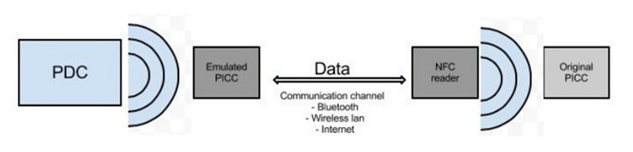
« NFC » well known attacks
Nowadays, constructors search to certificate their products. It depends of the implementation but NFC is attackable by:
Eavesdropping
Attacker uses an antenna to record the communication despite the short distance
Can corrupt the information, making them useless
Relay attack (protection : distance bounding protocol)
Data modification
Privacy
27-03-2017
Arabella Brayer
Notes:
http://proxmark.nl/files/Documents/13.56%20MHz%20-%20MIFARE%20DESFire/Cloning_Cryptographic_RFID_Cards_for_25USD-WISSEC_2010.pdf

Slide 13
Is that enough for...
Building Access control, car access control, etc.
Payments
Electronic ticketing for transportations
Healthcare, patient moniroting
Passport, identity cards…
?
27-03-2017
Arabella Brayer

Slide 14
Thank you
Reference list :
1 - S. (2016). Analyse de sécurité des applications d’authentification par NFC (Unpublished master's thesis). Montreal. Retrieved February 26, 2017, from https://publications.polymtl.ca/2149/1/2016_SabrineJdaida.pdf
2 - K., M., G., I., & K. (2009, May 01). Attacking smart card systems: Theory and practice. Retrieved March 26, 2017, from http://www.sciencedirect.com/science/article/pii/S136341270900017X
3 - Chiu, Y., Hong, W., Chou, L., Ding, J., Yang, B., & Cheng, C. (2013, November 27). A Practical Attack on Patched MIFARE Classic. Retrieved March 26, 2017, from http://link.springer.com/chapter/10.1007/978-3-319-12087-4_10
4 - The MIFARE Hack (Master's thesis, Radboud University Nijmegen) (pp. 1-14). (2012). Mathias Morbitzer.
5 - K., D., S., & H. (2008). Reverse-Engineering a Cryptographic RFID Tag (Master's thesis, University of Virginia, Chaos Computer Club Berlin, 2008) (pp. 185-193). USENIX Association. Retrieved March 26, 2017, from https://www.usenix.org/legacy/event/sec08/tech/full_papers/nohl/nohl.pdf

